Slide 1


Smart home and
building solutions.
Global. Secure. Connected
AGM Online
16th March 2023
Notes:
KNX UK AGM
Online via Zoom
16th March 2023
Members present:
Iain Gordon - GES (I) – Chair
Paul Foulkes – Theben (M) – Vice Chair
Graham Oliver - Jung UK (M)
Mark Warburton – Ivory Egg (W/T)
Andrew Ward – Wave Control (I)
Ryan Sheppard – Clanrye (W/T)
Seb Patton - Mosaic AV – (I)
Julian Barkes – BEMCO – (W/T)
Gordon Fry – BEMCO – (W/T)
Vidar Thomassen – Zennio – (M)
Chris Turner– Faradite – (M)
Andy Davis – Siemens
In Attendance:
Tracy Palazzo-Barnes – KNX UK
Apologies:
Paul Jones, B.E.G. - Lee Martin, Steinel and Paul Kinghorn My KNX Store

Slide 2
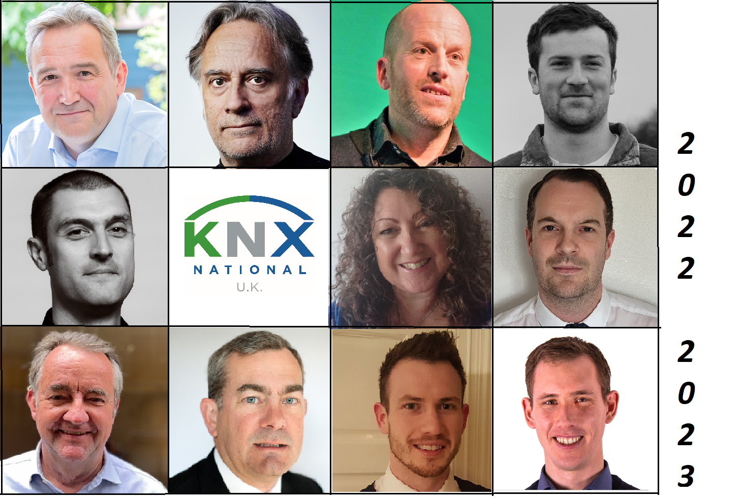
Structure and vision
2022 – 2023
Chair: Iain Gordon
Vice Chair: Paul Foulkes
Business Manager: Tracy Palazzo-Barnes
Founded: 2006
12 Manufacturers
28 Integrators
6 Distributors
5 Training Centres
36%
58%
20%
25%
Notes:
2022 / 2023 began with a huge shake up in membership fees, which required a really good look at our finances and the way the association is run. This was made possible partially via funding from Brussels and from funding saved on events that didn’t take place 2020/2021 and 2021/2022.
The Board voted to change the offices of President and Vice President to Chair and Vice Chair and changed the administrative role to one of Business Management, alleviating some of the responsibilities from the Chair and Vice Chair positions. It is hoped that this will encourage more volunteers to step forward for these roles in the future.
These changes coincided with a streamlining of older working practices to free up the time taken on basic administrative activities.
All Board meetings are now conducted online, reducing time and expense in travel and hours lost drastically. Discussions and decisions between Board meetings are conducted via email and online voting mechanisms, meaning more rapid action is possible. Items of concern and suggestions from members can be brought before the Board more quickly and members are encouraged to make full use of this when considering what they need from the association or what they would like to see more or less of.
The creation of working groups that focus on specific areas of association business and special projects has further increased our ability to implement changes more efficiently.
Iain Gordon remarked that numbers are rising again, we’d been forced to change the way we do things as a result of COVID closures which meant that people began to have a very different view of associations. Under the guidance of Paul Foulkes as President 2020 – 2022 – he felt that the figures are evidence of our growing success in the measures we’ve taken. He felt that the Board are working well and the dynamic between the Board and admin are working very well. He continued – all have taken steps to make valid change to the way KNX operates and appears to the market.

Slide 3
Board Elections
Manufacturer Seats:
Paul Foulkes, Theben 2023/2026
Paul Jones B.E,G, 2025
Graham Oliver, JUNG UK 2024
Lee Martin, Steinel 2023/2026
Integrator Seats:
Iain Gordon, GES Digital 2023/2026
Andrew Ward, Wave Controls 2025
Seb Patton, Mosaic AV 2025
Neil Grant, Harris Grant 2023 - Vacant
Distributor Seats:
Mark Warburton, Ivory Egg 2024
Ryan Sheppard, Clanrye Electrical 2025
Notes:
These are the current members of the Board, please note the Board position is held by the member, not the individual, so if there is a change of personnel or a change in personal circumstances the member company remains in situ, while the actual person representing them may change.
All Board seats are elected for a term of three years to maintain stability, although re-election dates vary as you can see. This year, Theben, GES, and Steinel were all up for re-election. Harris Grant has resigned due to retirement, so we had vacancies for four nominations to the Board. Theben, GES and Steinel all requested the opportunity for re-election and there have been no other nominations to contest these places. These Board Seats will now be renewed automatically and set for re-election in 2026. – Since we have had no other nominations for the vacancy being left by Harris Grant this position will remain vacant until we can encourage an Integrator member to take up the role.
It is not necessary to put these positions forward for a membership vote as there are no other contenders for these Board seats.

Slide 4
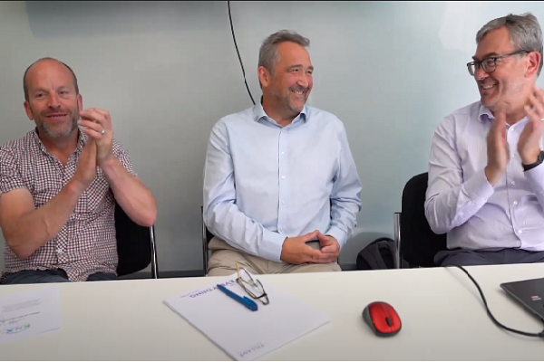
Events 2022
Annual Conference Futurebuild, ExCel London
KNX UK Awards
KNX Cyber Security, Energy Targets & Building Regs, Farnborough
EI Live, Farnborough
Light & Building,
Smart Buildings Show, ExCel London
London Build, Olympia London
KNX - The language of free and future-proof smart building controls
CEDIA Awards Dinner
Xmas Celebration, Kings Cross, London
Notes:
Annual conference and AGM at Excel London during the Futurebuild show, videographer filmed presentations and individual interviews so we also produced video footage to build our library of resources. On the day, there was a train strike and travel was awful, which led to a very low attendance and rethink about meetings.
KNX Secure Day – we combined KNX Secure with the new Building Regulations & Energy Targets that were going live in the UK at the same time. The event was organised as a Training Day for members and non-members and consisted of 3 Panel discussions and Q & A. – Again this was filmed and we have some good footage of the discussions that took place on our YouTube channel.
And you can see there were several other face to face events throughout the rest of the year and a great get together to round off the year.

Slide 5
“I found it very useful, there were varied sides of the industry which was great to see. I would really like to see more electrical manufacturers getting involved in future events.”
“the show was relevant and very useful. “
“I was surprised at the volume of ‘decision makers’ that attended the show, for example: Engineers, Architects, Interior Designers, etc… which was the ideal audience for us”
“Footfall was surprisingly good”
“I found it to be quite busy”
“I was chatting to people straight through for 2 – 3 hours”
“Footfall was patchy at times, but quality was generally better”
“I made 3 contacts, 1 of whom I am talking to this week”
“I had a few new interactions with potential/existing customers.”
“Very happy with the contacts and a good variety of leads to follow up on”
Events 2023
Specifying KNX for your BMS Projects
Futurebuild, ExCel London
Seminars at Futurebuild, ExCel London
KNX UK AGM – Online & Virtual
UL Solutions Test Lab Launch & Presentation
KNX UK Annual Conference & Awards
EI Live, Farnborough
Construction Week, Birmingham
Smart Buildings Show, ExCel London
Regional Training Events in London & Gateshead
Notes:
2023 started with an urgent request from a CPD provider to step in and help out with a cancellation, we had a week’s notice. Always keen to wave the KNX flag at every opportunity and since we now have a well populated resource library, we were able to help and once again we presented to specifiers we otherwise would not have had any contact with had we not been in the position to accept the challenge.
We have recently had a stand at the Futurebuild Show in March at ExCel, during which we also provided three seminars all of which were filmed and once ready will be available for further use. The slides are also available on request by any member and can be presented as CPD’s if required. The stand was provided free of charge by the organisers in return for publicity for their event, although there have been some expenses, roller banners, admin time, videographer for the seminars etc., expenses for attending such a show have been kept to a minimum.
Our involvement in the show since we began promoting it last September has increased our Social Media following and our mailing list of specifiers, end users and students. The latter built from zero to over 250 in just a few months, as a result of our attendance and pre-show activities, webinar and a newsletter showcase featuring Clanrye’s Ryan Sheppard representing KNX UK and other members.
In addition to this we are now being pursued by other exhibition organisers for similar agreements.
The feedback we have had on the show has been very positive. We had three Manufacturer members who took a stand at the show, all of whom have reported the show as being very successful for them - and several members who helped out on the KNX UK stand, a selection of whose comments you can see here in response to my questions after the show. – I would point out that the only cost to those attending the KNX UK Stand was time and travel. Whilst the main objective was to offer information on KNX in general, there were clearly overlaps to each member’s own business.
We have also been approached by other exhibition organisers for similar deals as Futurebuild.
We are providing a speaker for the UL Lab launch in the UK at the end of March and we are planning a big celebratory Annual Conference in June aimed at attracting M & E consultants and specifiers while showcasing our members, their products and projects.
We have split our AGM and Annual conference to make the most of our Events budget. We felt that the business of the AGM, although important, doesn’t necessarily
inspire the will to travel across the country in our post covid world. The Board therefore made the decision to provide the AGM online with a replay for those who can’t make the time and day of the live broadcast.
This leaves us free to plan a much more visitor friendly conference to which we can encourage external visitors as well as members to encourage those conversations that raise the profile of KNX and those who are passionate about it’s use for many differing reasons. We are looking for ideas and suggestions for this event, we want the event to stand on its own, without gimmicks, we are looking for speakers and content that will inspire those who want to know more about KNX and the benefits of a truly open protocol, not just for those of us who work with it, but for the building owners, occupiers and in terms of the environmental challenges we currently face.
The KNX UK Awards will also be a part of the Annual Conference and we really need some input for these, this is where you all come in. Entries can be submitted online and are free for Member companies.
Paul Foulkes mentioned that Theben had a stand there, he found it to be good and felt that visitors we were seeing are outside of our usual ‘church’ which was very useful. A lot of specifiers and interesting people there that we wouldn’t normally have access to.
Graham Oliver, wanted to point out that the addition of the Elizabeth Line has made ExCel much more accessible and found that the change in journey makes it a much more appealing venue for ourselves , but also for potential visitors.
Tracy remarked that there are likely to be speaking opportunities at various shows through the year and invited volunteers to step forward.

Slide 6
 | Jan 2022 | Jan 2023 | Mar 2023
LinkedIn | 552 | 903 | 1012
Facebook | 2257 | 2409 | 2421
Instagram | 445 | 589 | 686
Twitter | 2122 | 2177 | 2198
New Marketing Strategy
Social Media & Online Participation
Change to Marketing Strategy
Social Media
Webinars, Group events and panel discussions
Website Traffic and enquiries increased
Notes:
We changed our approach to marketing in 2022 – moving away from the PR activities of previous years and focused more on Social Media engagement and online activities. In particular we have focused on building our presence on LinkedIn, since this is a good place for us engage with specifiers.
We’ve focused on showcasing projects and products, highlighting personal interest stories involving our members and their clients via Social Media resulting in a growth in engagement, followers and website traffic.
Our website traffic has increased and so have enquiries from end-users, specifiers and potential members.
LinkedIn Analytics – last 30 days
Search Appearances 424 – 24.3%
Post Impressions 6.2K – 9.1%
New followers 42 – 13.5%
Graham Oliver, remarked as part of the marketing group, that Sue’s appointment has been a huge success, she’s very Social Media focused and accomplished in that area and that’s paying real dividends. Andrew Ward remarked that she is also really good at Sue helped him to edit an article that he wasn’t very confident about and turned it into something really good. He suggested that if anyone has a conversation they are having in the industry and want to turn it into a really good article, then Sue will really be able to help with this. Paul Foulkes agreed with this and remarked that he put a bit of a rant on LinkedIn and Sue picked up on it and changed it into a full article and it was published in the trade press. Tracy explained that part of the new focus is to publish more personal interest stories and opinion pieces as they can be far more engaging than just repeating that KNX is great.
Paul Foulkes reminded everyone to provide as much content as possible and how important it to get involved in building better buildings, sustainability, topics that are of interest in the construction industry and we can lead those conversations which in turn creates visibility for us and specifically for the association.
Tracy invited comment from members present. Chris Turner from Faradite commented that his colleague was impressed by Futurebuild, he remarked that they have only been outwardly promoting KNX as a Manufacturer since the launch of their KNX sensor a couple of months ago, but added that there will be a lot of marketing content from Faradite in the coming months. He further remarked on the education of electricians in Europe compared with the UK, in which so many newly qualified electricians in the UK have no idea about KNX as a protocol and wondered if this is an area KNX UK could get more involved in.
Vidar Thomassen from Zennio remarked that education is very important, but felt that all are missing out on a very vital sector. He went on to say that KNX has been very much regarded as high end residential in the UK – which is why it is often perceived to be expensive and it’s not. The use of KNX in the commercial sector is very much higher in other markets. If we are to grow KNX in the UK market we have to focus on this sector. He went on to say that Zennio has done 85,000 hotel rooms worldwide. We need to take action to change the perception of KNX as only for high-end residential projects. He continued that Zennio are currently working on some very large MDU’s in London – 500 apartments. KNX wasn’t in the specification, but it was a better and more economical solution than the original one. He also reported on a 700 bedroom hotel in London, they are working on. Tracy asked Vidar to share details on these projects, so that KNX UK can share these to help get the message out about large commercial endeavours and how they benefit.
Iain brought everyone’s attention to the fact that while the Board are involved in the day to day running of the Association, this doesn’t mean those who are not on the Board don’t have a voice. Anyone who feels they have something to say or contribute, should get in touch. He agreed with Vidar entirely the approach to seeing the possibilities of KNX as a cheaper solutions, to debunk the idea of only using it in high-end residential is very relevant. We need to make those who build large scale MDU’s aware of it through case study evidence etc., that it can be the best and the most cost-effective solution. He encouraged everyone present to get involved to achieve the common objective.
Chris pointed out that many manufacturers work together and are not necessarily direct competitors, he mentioned that there are some Zennio projects that are using Faradite sensors – these type of stories are the kind of thing KNX UK needs to being sharing throughout the trade press and social media to show how diverse and adaptable KNX is.
Paul pointed out that the beauty of Social Media and our growth in this are means that we can keep repeating the sema message over and over again, Rewriting from different angles, reposting, repeating the message we want to get out over and over again. He mentioned he has a case study from Holland in which KNX has been used extensively in a social housing project, Vidar added that their MDU project includes affordable housing. Getting this message out will be really powerful Paul invited others to add to these stories with their own experiences etc., so we can create some really good contents in the months to come.

Slide 7

STOP PRESS
Coming soon – 1st April 2023
ECS Card for KNX UK Members with Partner Status
Notes:
We now have an agreement with the ECA to provide KNX UK Members with an ECS card for site access.
Association membership is required – the agreement is with KNX UK, we will be responsible for administering the process which includes assessments. The cost will be an additional £90 plus VAT It is hoped that this will attract more Integrator members.
Iain clarified the ECS card is the electrotechnical card that is part of the Health & Safety card system used for contractors to prove their safety and qualifications on site. KNX UK Has manged to get KNX certification to be recognised by the ECA and the JIB (Joint Industries Board) to be included as a recognised qualification as part of this scheme. KNX UK is the partner association so this is something we can manage for our members and provide as a benefit. CSCS and ECS organisations are pushing really hard for all sites regardless of size be required to implement the card system enabling only those in possession of the cards to access the site.
Over time they require our members to do an electrotechnical certification, which could open up further opportunities for our Training Centre Members or perhaps our Manufacturer members.

Slide 8
 | Income | Expenditure | Profit/Loss | Cashflow
2022 | 59,000 | 35,000 | 8,700 | 29,000
2023 | 38,000 | 50,000 | -12,000 | 22,000
2024 | 34,000 | 45,000 | -13,000 | 12,000
Financial Overview
Funding from KNXA
Increase in membership numbers
Reduction in costs
Focus on ROI
Non-profit
To raise the profile of KNX in the UK and to support our members.
Notes:
We ended 2022 with a surplus, due to lack of activities during COVID – 20 & 21, this was partly how we were able to pass these savings onto our members and reduce the fees across the board.
These calculations included an expectation of losses for subsequent years, but as you can see, although the balance in the bank is reducing, we will remain solvent. As our membership grows the current trend will begin to stabilise and reverse. - more on this on the next slide
The estimated costs for the current financial year include money set aside for the Annual Conference and several smaller regional events, we have been offered joint events at some of our training centre member’s, which will help with venue costs, more detail on those as we are able finalise details.
Chris Turner asked about the legal structure of KNX UK, which is a Not for Profit Company Limited by Guarantee.
Iain mentioned that the viewpoint when we all went into Covid three years ago was that some fairly major changes were going to be needed. The whole fee structure has been re-organised and this is one of the reasons our income has dropped, membership has increase so although the income has dropped and the forecast for the coming year is showing a loss that isn’t necessarily where we are going to be, the actions we are taking and the increased reasons for membership will all be instrumental in improving this picture. He also mentioned that we have had some funding from Brussels a few times over the past few years.
Chris asked about government grants, it was agreed that this is an area that could be looked into, especially in terms of KNX and its connection to sustainability and green initiatives.

Slide 9
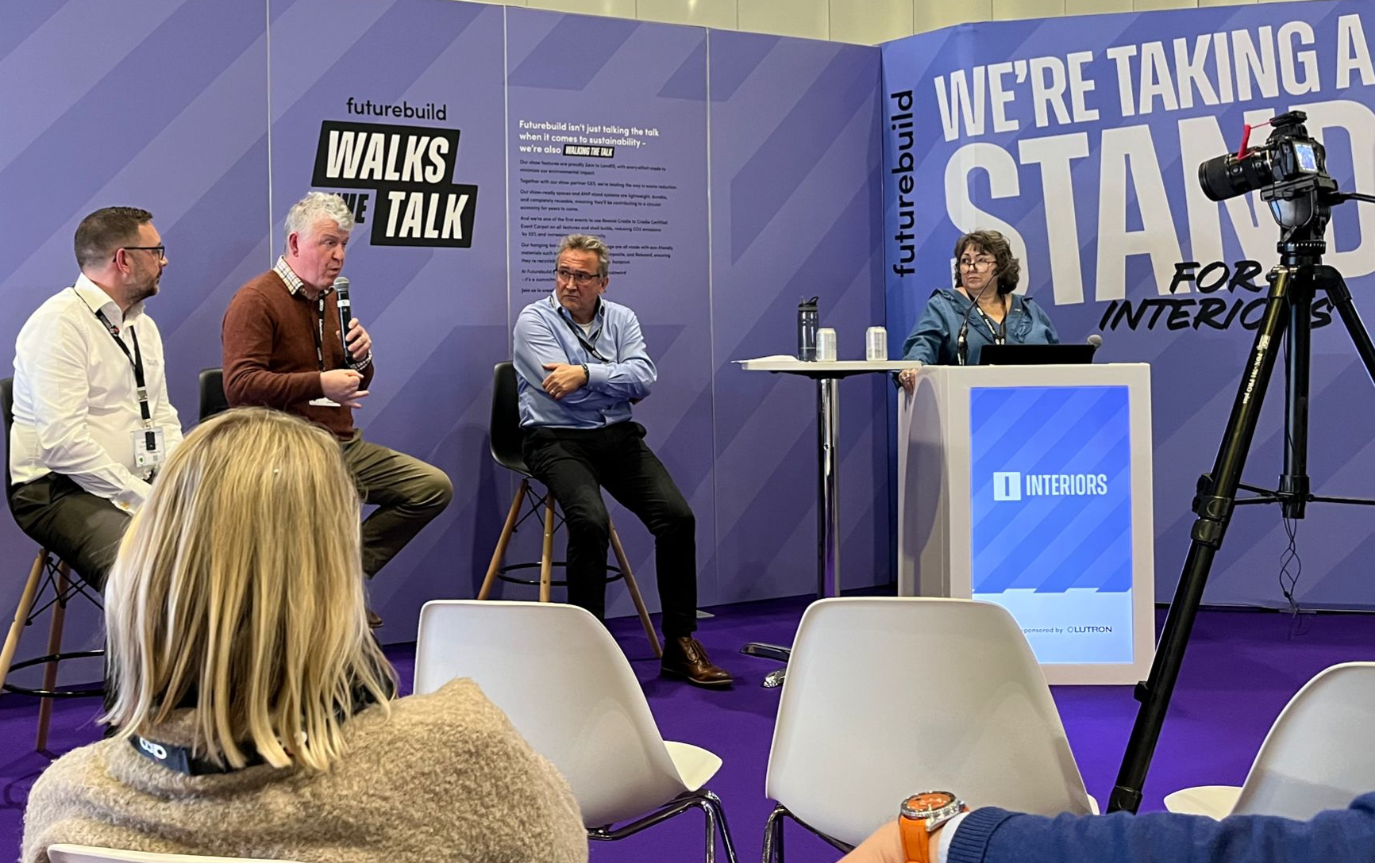
Engagement, getting the most out of KNX UK Membership
Email
WhatsApp
LinkedIn Group
Dedicated Webpage
Speaking and Publicity Opportunities
Events and Exhibitions
Notes:
Attendees were invited to discuss favoured ways of staying in touch to create an environment for closer engagement. Generally attendees felt that email and a LinkedIn group are preferable, having too many platforms can be too complex. Whilst it is great to have the conversations with a few members online as with this meeting, imagine how much more we could achieve if we could get everyone talking and contributing.

Slide 10

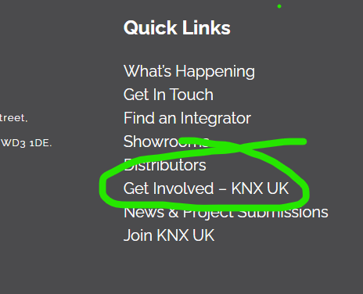
Members Suggestions, Q & A
Suggestions Box – www.knxuk.org/get-involved-knx-uk
Email: admin@knxuk.org
LinkedIn Messaging
Project & Content Submissions – www.knxuk.org/submissions
Assign the right people in your company for KNX UK comms
Let’s open up the floor now
– questions, comments, opinions?
Notes:
We need your involvement, we need to know what you want from your association, what you’d like to see more of
We need you to share your news and views – we have a growing voice, but ours is not just one voice, it is made up of many voices from all of you, all with your own particular perspective and experiences - share yours, make suggestions, ask questions, ask about upcoming opportunities.
Please send questions, feedback and suggestions to admin@knxuk.org or use any of the above links. Stay in touch, make the most of your membership.
Attendees were invited to suggest what people might want in the coming 12 months. The biggest initiative seems to be in pushing the
Graham Oliver appealed to all for more stories that can be published, Iain remarked that most of the stories are about high-end residential installations and all discussed and agreed that larger commercial projects need to be added into this mix to show more diversity in the way KNX is used and also some more lower end residential. The discussion continued about the need for greater understanding of KNX as a protocol and not as a brand for luxury living. Demonstrating the commercial application for KNX will be vital in turning around the false perception in the UK market of it as purely a fringe tool for custom installations.
It was also noted that in mainland Europe the split between Commercial and Residential applications of KNX is 70% Commercial and 30% Residential in the UK it is the opposite. There is much to do.
Andrew Ward suggested that KNX should embark on a campaign showing that KNX ‘works with’, while this has been used before Iain pointed out that Integrators could create the story and KNX UK could publicise this. Andy Davies of Siemens suggested that we could get a ‘works with’ graphic to use on Social Media posts – Iain suggested approaching KNXA for a branded graphic.
Vidar also pointed out that promoting the ‘works with’ message is important in terms of commercial applications, to point out that KNX works with modbus and others.
While the CI market has been where all the KNX focus and interest has been in the past 3 – 5 years and we as an association has followed this trend to promote our members and talk to those who have an interest in using KNX in the UK, there is a need to broaden our message to include this, but also to demonstrate how else it can and is being deployed here and globally.
These questions and suggestions will be added as an agenda item to the next Board meeting and it is likely a working group will be formed to address this. Further discussions on this point included the need for manufacturer input into KNX UK, so we can promote more commercial projects alongside the CI projects and also the coming requirements for schools and doctors surgeries to be more automated as a regulation – (EBPD), which provide the opportunity to show how KNX can provide the solutions to these type of buildings.
It was also suggested that we need to present KNX as a complete solution, rather than focusing on products or even projects.
Iain thanked everyone for their time and input and reiterated the importance of keeping the conversations and ideas going, not just once a year, but throughout the year so we can all achieve our joint objectives.

